Slide 1
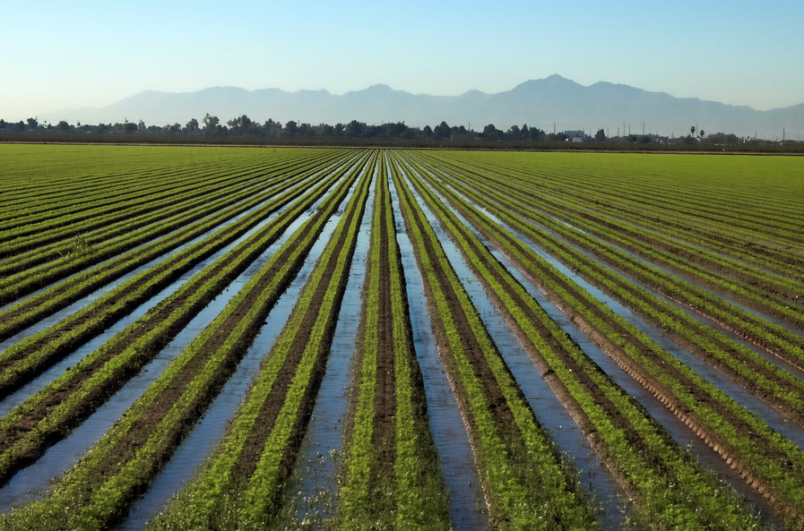


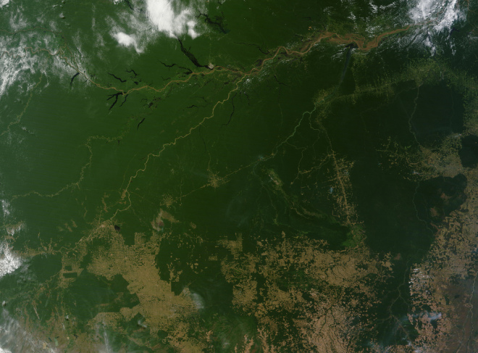
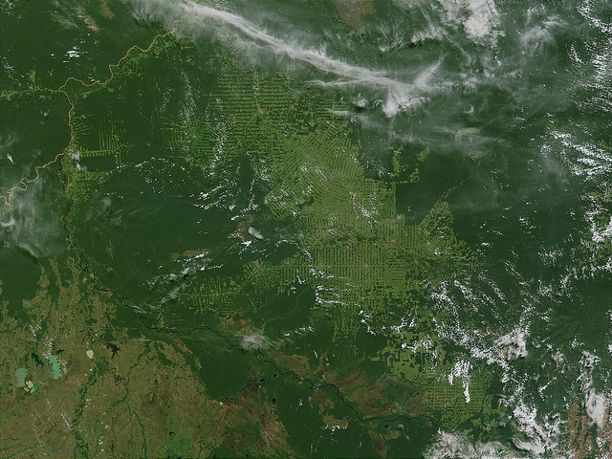
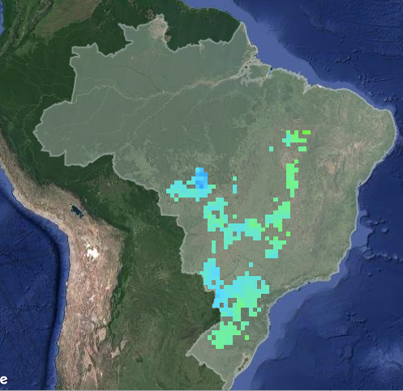
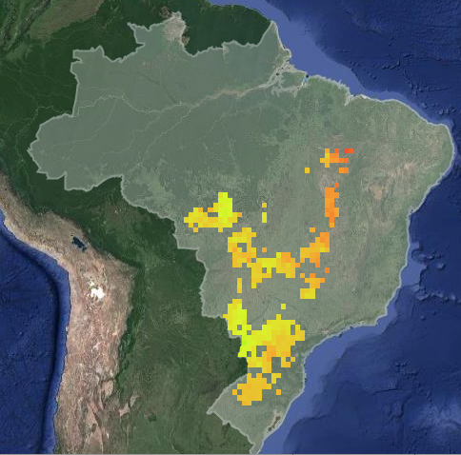
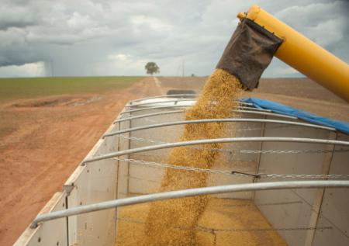
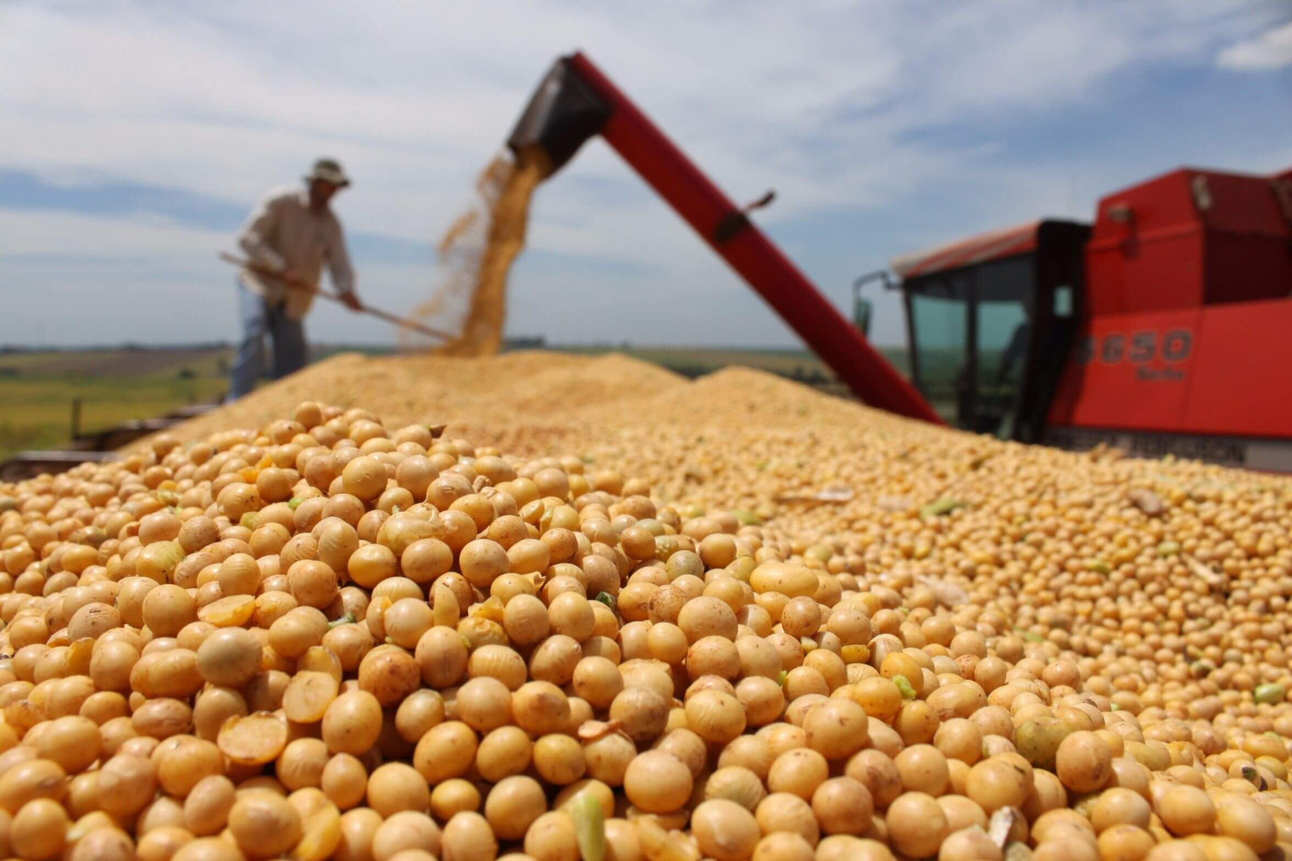

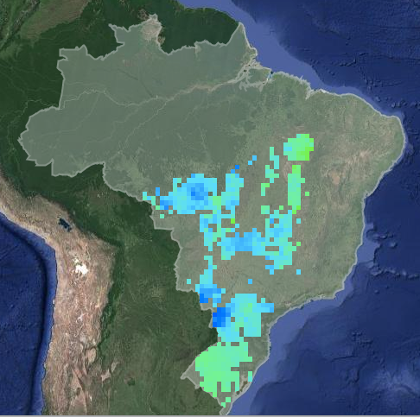
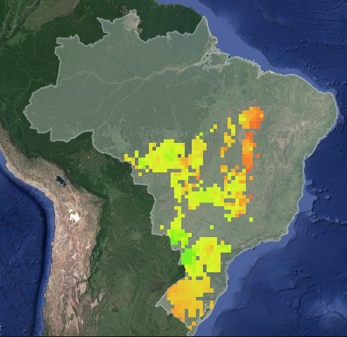
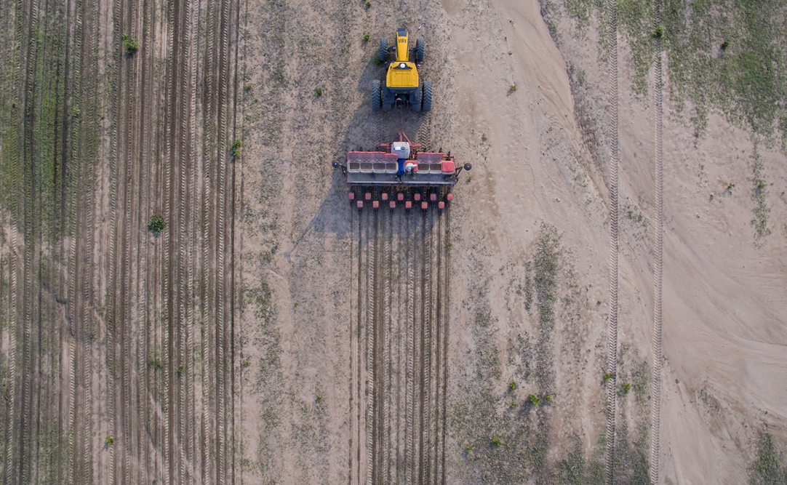
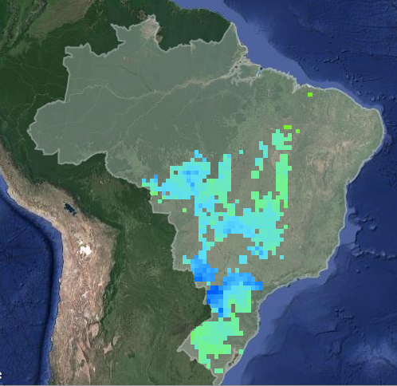
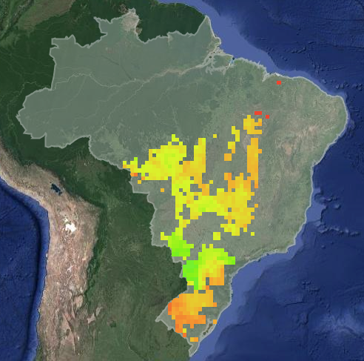
Remotely sensed estimates of soybean planting and harvest dates in Brazil
Minghui Zhang¹, Dr. Sally Thompson¹, Dr. Avery Cohn²
¹University of California, Berkeley
²Tufts University
minghuiz@berkeley.edu
Deforestation in Brazil creates a ‘no win’ scenario for agricultural production
Remotely sensed information can illuminate the role of crop timing in this ‘no win’ scenario
MODIS-derived crop timing estimates
Historical crop timing and climate data will characterize crop timing’s response to climate change. The shift in crop timing can be translated to a change in agricultural yield.
Planting date
Harvest date
2005
2005
2015
2015
Field scale crop timing data do not exist in Brazil, but can be estimated with remotely sensed data.
Timeseries analysis of MODIS data produces crop timing estimates
(Oliveira et al, 2013)
Crop timing decisions play a role in this ‘no win’ scenario
The enhanced vegetation index (EVI) responds to soy growth.
Land use change
Climate change
Crop timing
Agricultural productivity
Timeseries analysis of MODIS-derived EVI produces field scale (500m) estimates of soybean planting and harvest dates across Brazil.
2016
2016
In Brazil, a one-month reduction in the wet season is predicted by end of this century (Sampaio et al, 2007).
A shifting wet season is expected to force planting and harvest dates to suboptimal times and may change cropping intensity from double to single cropping.
Planting date (since Aug 1)
Harvest date (since Aug 1)

